Slide 1
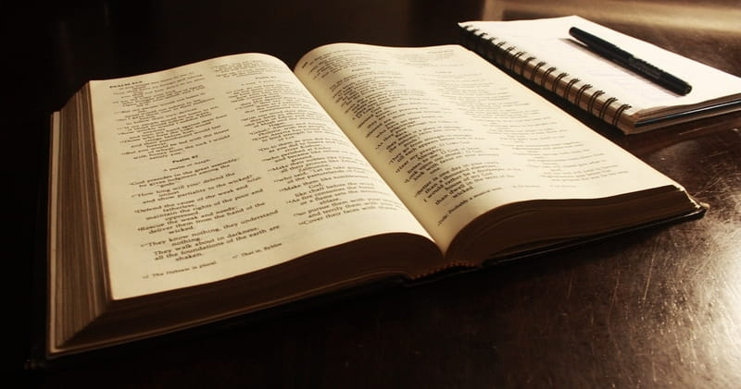
BIBLICAL SELF-CONTROL
Daniel 1 Galatians 5

Slide 3
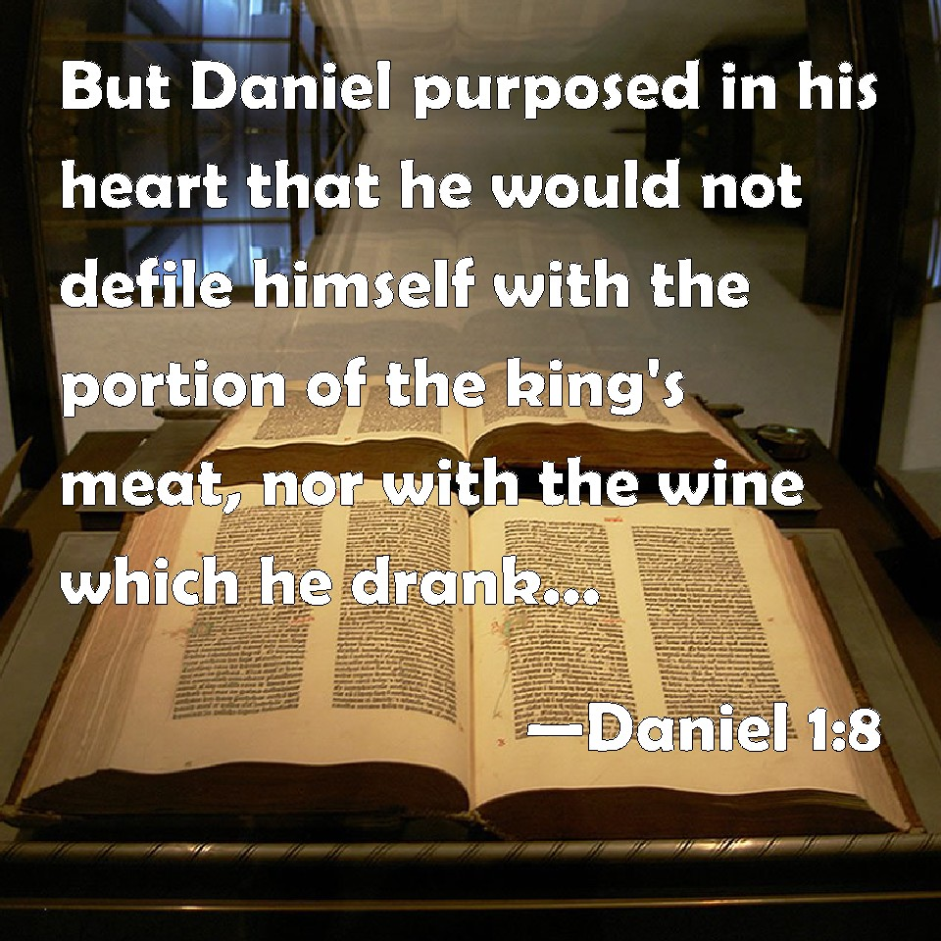

Slide 5
BIBLICAL SELF-CONTROL
Daniel 1 Galatians 5

Slide 7
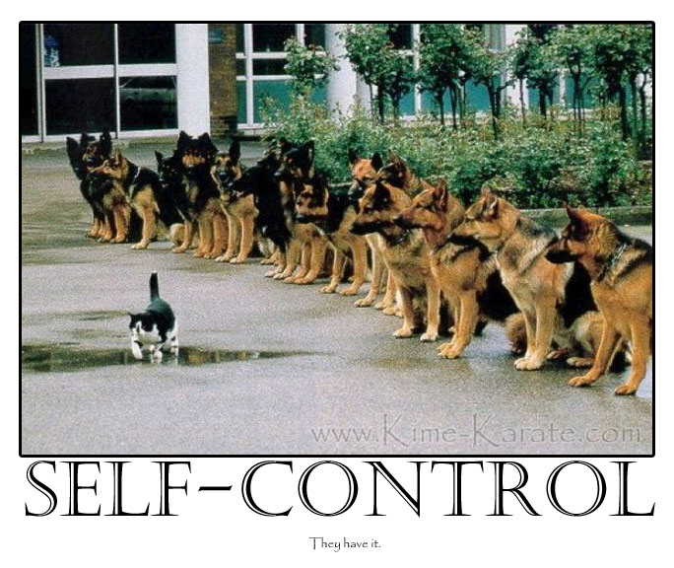
Restraint exercised over one’s own impulses, emotions, passions or desires.

Slide 8
BIBLICAL SELF-CONTROL (What’s it Look Like)
Restraint exercised over one’s own impulses, emotions, passions or desires.
Choosing to HONOR GOD

Slide 9
BIBLICAL SELF-CONTROL (Is It Important)

Slide 11
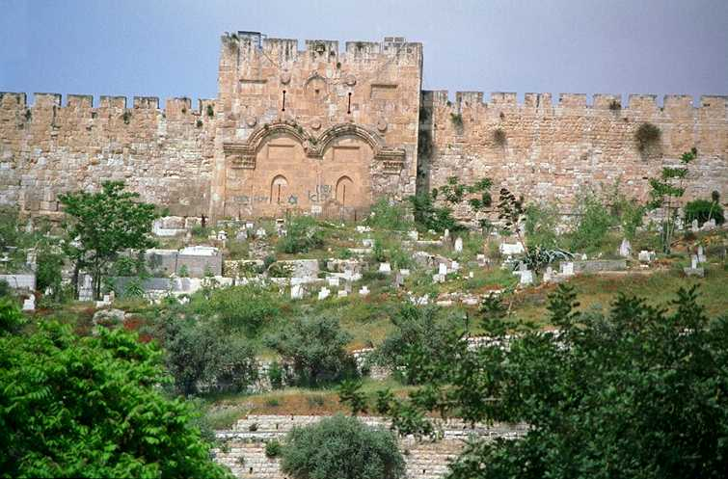

Slide 12
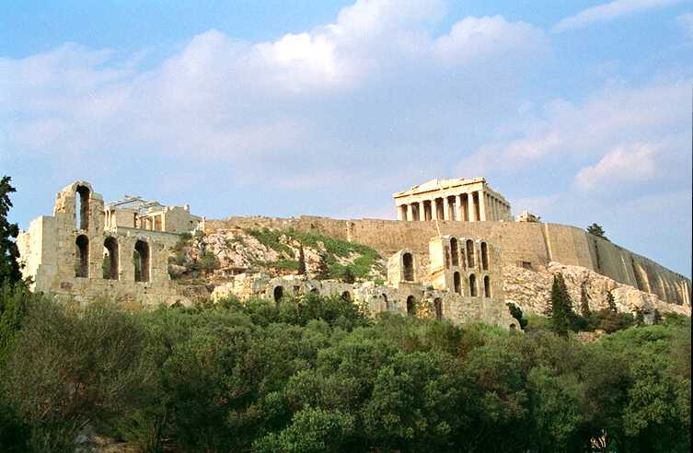

Slide 13
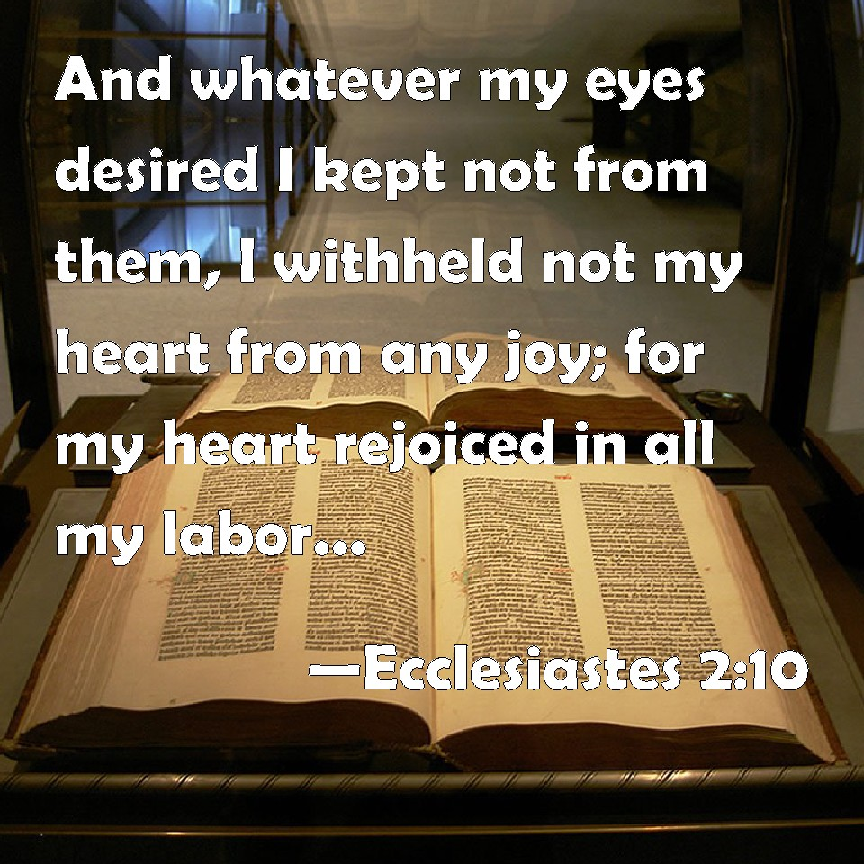

Slide 14
BIBLICAL SELF-CONTROL (Is It Important)
A man who lacks self-control is like a city W/O walls.
He is VULNERABLE.
Satan is looking for a CRACK/OPENING in our wall

Slide 15
BIBLICAL SELF-CONTROL (Walking in Biblical Self-Control)
Key Words/Steps in Developing Self-Control
I. PURPOSE
I will not defile myself

Slide 16
Matthew 22:37
Jesus said unto him, Thou shalt love the Lord thy God with all thy heart, and with all thy soul, and with all thy mind.

Slide 17
BIBLICAL SELF-CONTROL (Walking in Biblical Self-Control)
Key Words/Steps in Developing Self-Control
I. PURPOSE
I will not defile myself
II. PROBLEM
Identify the problem

Slide 18
BIBLICAL SELF-CONTROL (Walking in Biblical Self-Control)
Key Words/Steps in Developing Self-Control
I. PURPOSE
I will not defile myself
II. PROBLEM
Identify the problem
III. PLAN
Make a Strategy

Slide 19
BIBLICAL SELF-CONTROL (Walking in Biblical Self-Control)
Key Words/Steps in Developing Self-Control
I. PURPOSE
I will not defile myself
IN THE SPIRIT
II. PROBLEM
Identify the problem
III. PLAN
Make a Strategy

Slide 23
Matthew 22:37
Jesus said unto him, Thou shalt love the Lord thy God with all thy heart, and with all thy soul, and with all thy mind.

Slide 24
Matthew 22:37
Jesus said unto him, Thou shalt love the Lord thy God with all thy heart, and with all thy soul, and with all thy mind.

Slide 25
BIBLICAL SELF-CONTROL (What’s it Look Like)

Slide 27
BIBLICAL SELF-CONTROL (Walking in Biblical Self-Control)

Slide 28
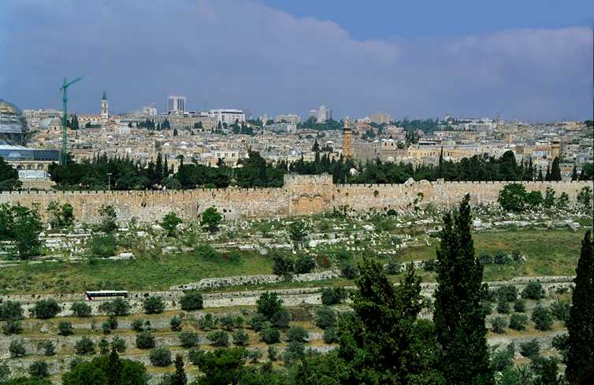

Slide 34
For it is God which worketh in you both to will and to do of his good pleasure. Philippians 2:13

Slide 35
1. PRAY 2. DELIGHT YOURSELF IN THE LORD 3. STUDY 4. PRACTICE
COOPERATE WITH GOD
Growing to be like Christ

Slide 36
²³ Search me, O God, and know my heart: try me, and know my thoughts: ²⁴ And see if there be any wicked way in me, and lead me in the way everlasting. PS. 139:23-24
COOPERATE WITH GOD
Growing to be like Christ

Slide 37
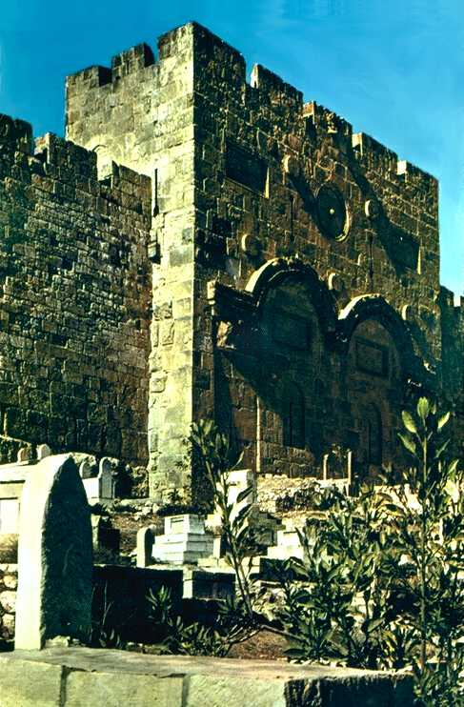

Slide 38
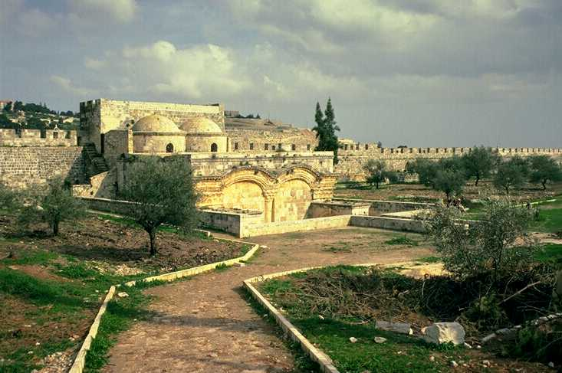

Slide 39
Ecclesiastes 2:10 And whatsoever mine eyes desired I kept not from them, I withheld not my heart from any joy; for my heart rejoiced in all my labour: and this was my portion of all my labour

