Slide 1
Be wise in what is good
Romans 16
Galatians 6

Slide 2
Jeremiah 4:22
“For My people are foolish, they have not known Me. They are silly children, and they have no understanding. They are wise to do evil, but to do good they have no knowledge.”

Slide 3
Do children know what is good and what is evil?

Slide 4
Deuteronomy 1:39
Moreover your little ones and your children, who you say will be victims, who today have no knowledge of good and evil, they shall go in there; to them I will give it, and they shall possess it.

Slide 5
Isaiah 7:16
For before the Child shall know to refuse the evil and choose the good, the land that you dread will be forsaken by both her kings.

Slide 6
What do we do to know what is good and right in God’s eyes?

Slide 7
What do we do to know what is good and right in God’s eyes?
1) Read God’s Word

Slide 8
Psalm 119:9-11
How can a young man cleanse his way? By taking heed according to Your word. ¹⁰ With my whole heart I have sought You; Oh, let me not wander from Your commandments! ¹¹ Your word I have hidden in my heart, That I might not sin against You.

Slide 9
1 peter 2:2
as newborn babes, desire the pure milk of the word, that you may grow thereby,

Slide 10
What do we do to know what is good and right in God’s eyes?
Read God’s Word
Apply what you’ve learned

Slide 11
Hebrews 5:13-14
For everyone who partakes only of milk is unskilled in the word of righteousness, for he is a babe. 14 But solid food belongs to those who are of full age, that is, those who by reason of use have their senses exercised to discern both good and evil.

Slide 12
1 Corinthians 14:20
Brethren, do not be children in understanding; however, in malice be babes, but in understanding be mature.

Slide 13
What do we do to know what is good and right in God’s eyes?
Read God’s Word
Apply what you’ve learned
Allow others to teach you

Slide 14
1 Samuel 12:23
Moreover, as for me, far be it from me that I should sin against the Lord in ceasing to pray for you; but I will teach you the good and the right way.

Slide 15
Ephesians 4:13-14
till we all come to the unity of the faith and of the knowledge of the Son of God, to a perfect man, to the measure of the stature of the fullness of Christ; 14 that we should no longer be children, tossed to and fro and carried about with every wind of doctrine, by the trickery of men, in the cunning craftiness of deceitful plotting,

Slide 16
What do we do to know what is good and right in God’s eyes?
Read God’s Word
Apply what you’ve learned
Allow others to teach you
Don’t change your doctrine

Slide 17
Isaiah 5:20
Woe to those who call evil good, and good evil; Who put darkness for light, and light for darkness; Who put bitter for sweet, and sweet for bitter!

Slide 18
2 Corinthians 11:13-14
For such are false apostles, deceitful workers, transforming themselves into apostles of Christ. 14 And no wonder! For Satan himself transforms himself into an angel of light.

Slide 19
Why is import to be wise in what is good but be innocent in what is evil?

Slide 20
Deuteronomy 6:18
And you shall do what is right and good in the sight of the Lord, that it may be well with you, and that you may go in and possess the good land of which the Lord swore to your fathers,

Slide 21
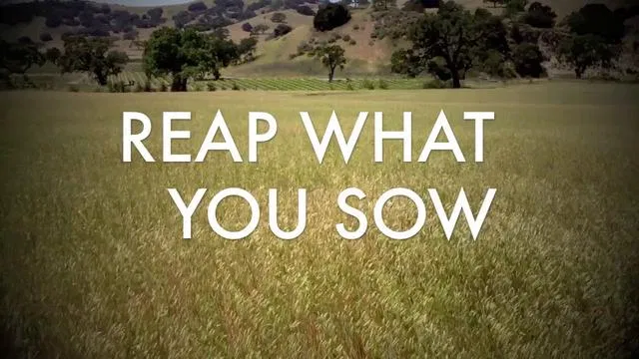

Slide 22
2 Corinthians 9:6
But this I say: He who sows sparingly will also reap sparingly, and he who sows bountifully will also reap bountifully.

Slide 23
3 John 1:11
Beloved, do not imitate what is evil, but what is good. He who does good is of God, but he who does evil has not seen God.

