Slide 1
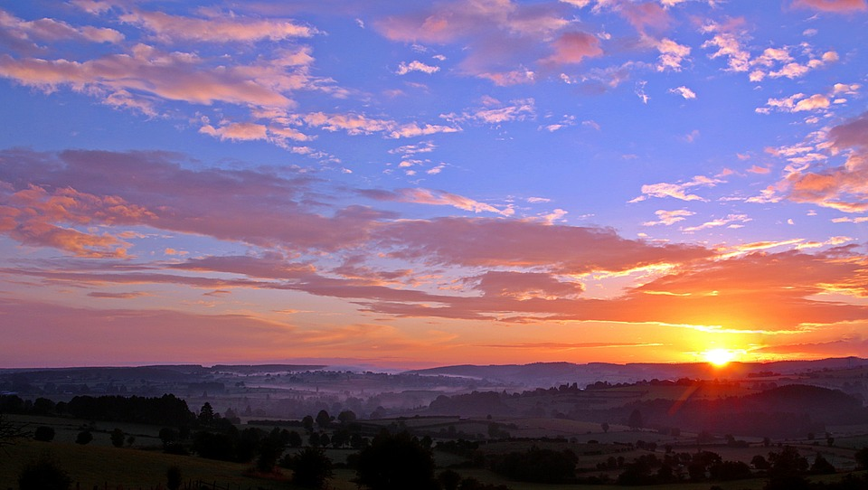
They Didn’t Ask
Reasons to Pray
Joshua 9
Joshua 9:14 And the men took of their victuals, and asked not counsel at the mouth of the Lord.

Slide 2
Reasons to Pray
I. Jesus Prayed
It’s God’s will that we pray
Mark 1:35 And in the morning, rising up a great while before day, he went out, and departed into a solitary place, and there prayed.

Slide 3
Reasons to Pray
Mat 6:6 But thou, when thou prayest, enter into thy closet, and when thou hast shut thy door, pray to thy Father which is in secret; and thy Father which seeth in secret shall reward thee openly.

Slide 4
Reasons to Pray
I. Jesus Prayed
It’s God’s will that we pray
Mark 1:35 And in the morning, rising up a great while before day, he went out, and departed into a solitary place, and there prayed.

Slide 5
Reasons to Pray
I. Jesus Prayed
It’s God’s will that we pray
Mark 1:35 And in the MORNING, rising up a great while before day, he went out, and departed into a solitary place, and there prayed.

Slide 6
Reasons to Pray
I. Jesus Prayed
It’s God’s will that we pray
Mark 1:35 And in the MORNING, rising up a great while before day, he went out, and departed into a SOLITARY PLACE, and there prayed.

Slide 7
Reasons to Pray
Luke 18:1 And he spake a parable unto them to this end, that men ought always to pray, and not to faint;

Slide 8
Reasons to Pray
“If He, the sinless One, He the mighty One, He the divine One, felt deeply and momentarily….. the need of drawing from above by the breath of prayer those supplies needful for the accomplishment of His work and for glorifying His Father. Oh, how much more have we need that prayer should precede and accompany, and follow every step we take”. Octavius Winslow

Slide 9
Reasons to Pray
I. Jesus Prayed
It’s God’s will that we pray
II. Man is Limited in his Knowledge & Wisdom
God has Infinite Knowledge & Wisdom

Slide 10
Reasons to Pray
Job 36:5 Behold, God is mighty, and despiseth not any: he is mighty in strength and wisdom.

Slide 11
Reasons to Pray
I. Jesus Prayed
It’s God’s will that we pray
II. Man is Limited in his Knowledge & Wisdom
God has Infinite Knowledge & Wisdom
III. The Enemy is Wily
It’s DANGEROUS not to PRAY

Slide 12
Reasons to Pray
The Enemy is Wily Therefore it is DANGEROUS not to PRAY
He was a murderer from the beginning, and abode not in the truth, because there is no truth in him. When he speaketh a lie, he speaketh of his own: for he is a liar, and the father of it.

Slide 13
Reasons to Pray
The Enemy is Wily Therefore it is DANGEROUS not to PRAY
1 Thessalonians 3:5 For this cause, when I could no longer forbear, I sent to know your faith, lest by some means the tempter have tempted you, and our labour be in vain.

Slide 14
Reasons to Pray
The Enemy is Wily Therefore it is DANGEROUS not to PRAY
1 Peter 5:8 Be sober, be vigilant; because your adversary the devil, as a roaring lion, walketh about, seeking whom he may devour:

Slide 15
Reasons to Pray

